Slide 1
OPERATION CASE
I & II

Slide 2








Starting professional career in Oil and Gas Industry for a decade.
Extending expertise in Data Technology and its application focusing on but not limited to Big Data, Data Mining and Machine Learning.
Strong believer that education is the top powerful life-changer, and that data driven decision is most of the time the best decision.
E D U W O R K I N T E R E S T
Yunan Putranto
Email : yunanto.putranto@gmail.com, yunanto@datalabs.id
LinkedIn : https://www.linkedin.com/in/yunan-putranto-b045943b/
Proprietary document of IYKRA, 2018

Slide 3
Agenda
Session 0: Brief review of past topic ‘Forecasting’
Session 1: Machine Learning Checklist
Session 2: Operation Case I (9 Jul 2018)
Session 3: Operation Case II (10 Jul 2018)

Slide 4
Objective
Exposed to real case with real data
Implement ML process end-to-end
Refreshment of machine learning topics
Get familiar to online resources

Slide 5


Previous Topic
Forecasting
Session 0

Slide 6
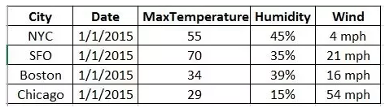
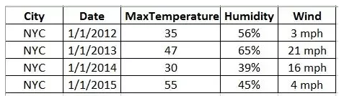
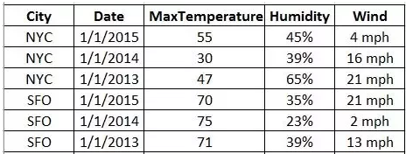
Data Type
Cross Section
Multiple objects
Single point in time
Time Series
Single object
Different time intervals
Panel/Longitudinal
Cross-sectional TS
Multiple objects
Different time intervals
https://www.quora.com/What-is-the-difference-between-panel-data-time-serial-data-and-cross-sectional-data

Slide 7
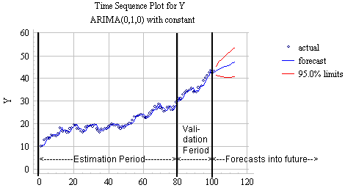
TS Analysis and Forecast
TS Analysis
Extract useful statistical information
TS Forecast
Use model
Predict future value
Based on past time / historical values
http://home.ubalt.edu/ntsbarsh/stat-data/forecast.htm

Slide 8
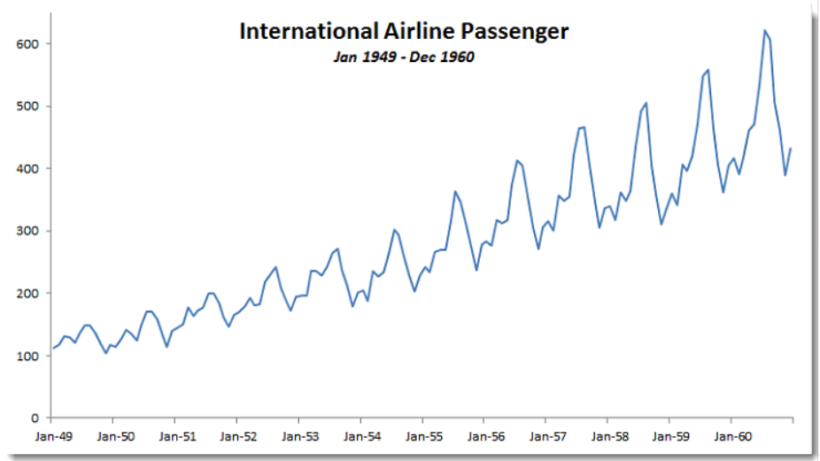
Example
International Airline Passenger
Increasing Trend
Seasonal Time Series
http://www.spiderfinancial.com/support/documentation/numxl/tips-and-tricks/text-book-example-airline-passenger-data

Slide 9
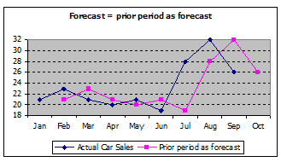
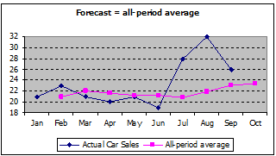
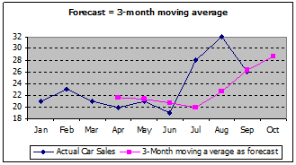
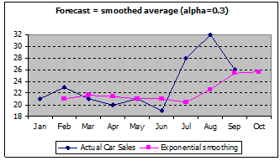
Forecasting Approach
Prior Period
All-period average
Moving Average
Smoothing Average

Slide 10
ML Check Point
INDIVIDUAL TASK
Session 1

Slide 11

We’ve been learning various topics
Feature Engineering
Derivative var, discretize, ..
Data Import
Data type
Variable, List, Boolean, DF, ..
ML Application
Regression, Classification, Segmentation
Library
Pandas, Numpy, Matplotlib, ..
ML Algorithm
Reg, RegLog, Tree, RF, ..
Visualization
Boxplot, Barplot, Hist, Density, ..
Model Evaluation
ROC, Confusion Matrix, ..

Slide 12

Operation Cases
Combine the puzzle pieces into 1 picture
Accommodate us to understand the flow, end to end
Expose us to real case scenario

Slide 13


We’re almost to the ‘finish’ line
FINISH STRONG TOGETHER

Slide 14

Check Point
This is an Individual Task
Refreshment of what have been learnt
Opportunity to catch up
Finish STRONG TOGETHER
CP #1
CP #1
CP #1
CP #10

Slide 15
CP #1 : Preparation
System Check
Python version
Functionality: Simple algebra, print any string
Library loading
DF operation, data transformation, visualization
Data Set loading
Load 3 provided datasets
Note:
- Keep in mind file type and separator
- On Student Data (X1: Student_ID, X2: First name,
X3: Last Name, X4: Gender, X5: Age, X6: Dept_ID)
Useful link: stackoverflow, tutorialspoint

Slide 16
CP #2 : Data Quick look
Quick look
Data View
Dimension
Variable data type
Number of unique value
Statistics Summary for numerical data
Missing Value & Duplications
Identify and count number of missing value
Identify duplications

Slide 17
CP #3 : Miscellaneous Handling
Change column names
Change column names
Data (X1: Student_ID, X2: First name,
X3: Last Name, X4: Gender, X5: Age, X6: Dept_ID)
Handling missing & duplicated data
Drop duplications
Drop row (rule = drop row if ‘First name’ is missing)
Replace value (rule = fill missing value with means of age)
Data type adjustment
Change to appropriate data type
Challenge: do for multiple columns at once

Slide 18
CP #4 : Selection & Subset
Selection
Row selection
Show Female student record
Show Male student whose the Age > 20
Column selection
- Show student DF except Dept_ID
Subset
Create new DF called ‘demography’. It is student DF that contains only columns ‘First name’, ‘Last name’, ‘Gender’ and ‘Age’

Slide 19
CP #5 : Transformation
Conditional Statement
Labeling numeric variables with conditional statement
Labeling ‘Mark’ to ‘Score’
Col name: ‘Score’.
Rule: A=4, AB=3.5, B=3
Derivative Variable
Create new variable from existing one(s)
Col name: ‘Total score’
Rule: ‘total score’ = ‘weight’ * ‘score’

Slide 20
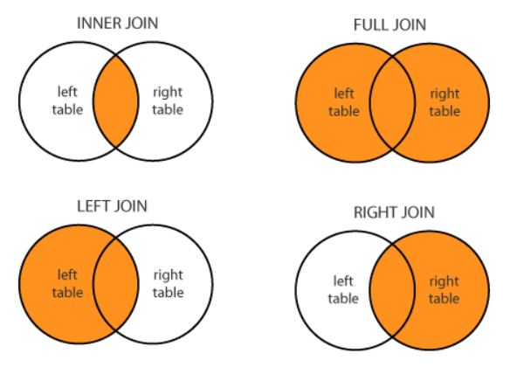
CP #6: Joining table
Join / Merge
Left join
Right join
Inner join
Full join
Concat
By row
By column
Task:
Join student, score and department tables
Keep only student who has score record

Slide 21
CP #7: Aggregation & Sorting
Aggregation
Group by single / multiple columns
Various function: sum, count, mean, etc
Sorting
Sorting by single / multiple columns
Ascending / Descending
Task:
Aggregate total weight and total score for each student
Calculate GPA = sum(total score) / sum(Weight) for each student
GPA with 2 digit decimal
Sort student from highest GPA

Slide 22
CP #8: Visualization
Viz for Numerical Var
Boxplot
Histogram
Density Plot
Line plot
Viz for Categorical Var
Bar Plot
Pie Chart
Task:
Bar plot for GPA vs Student, sorted from highest GPA
Histogram for age (all student)

Slide 23

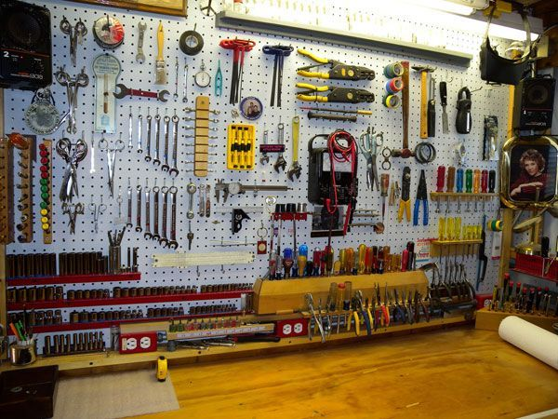


‘Ammunition’ organization
60mins
20mins

Slide 24
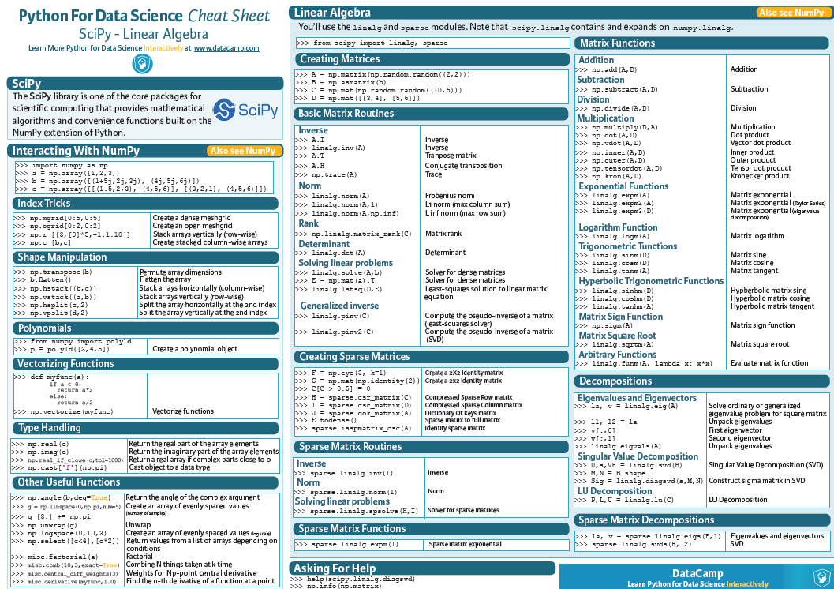
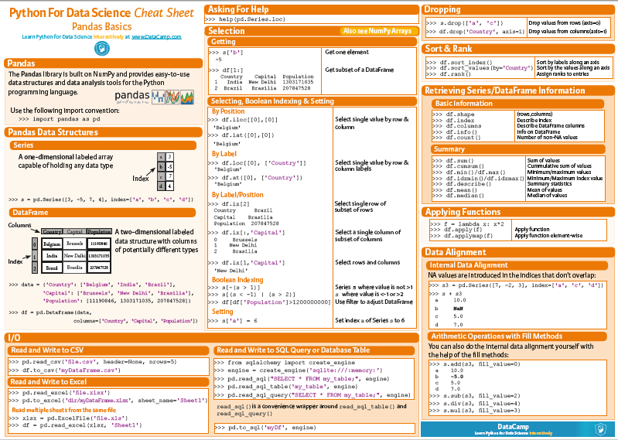
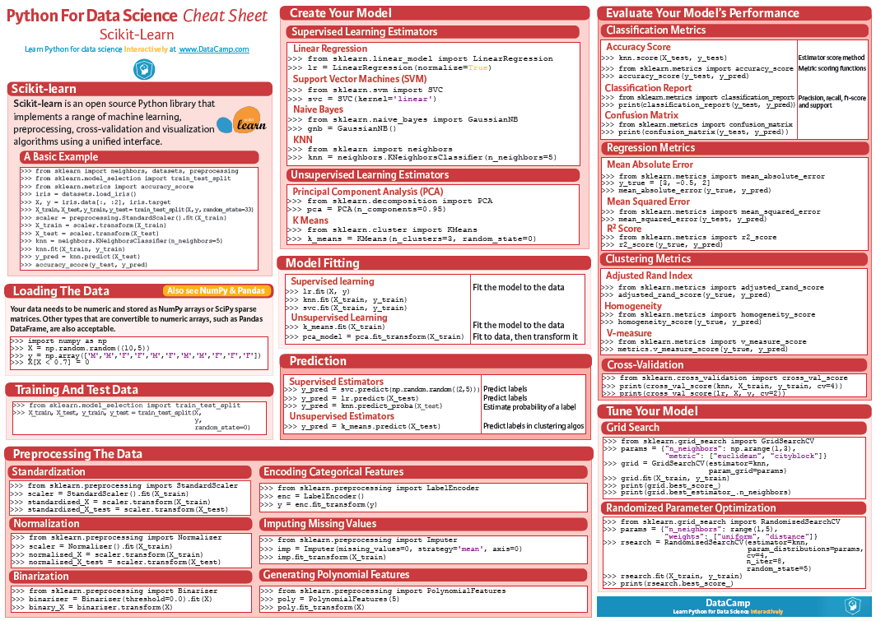




‘Ammunition’ organization
+
Python for DS
Pandas
Scikit-Learn
+
+
=

Slide 25
9 Jul 2018
Operation Case I
GROUP TASK
Session 2

Slide 26

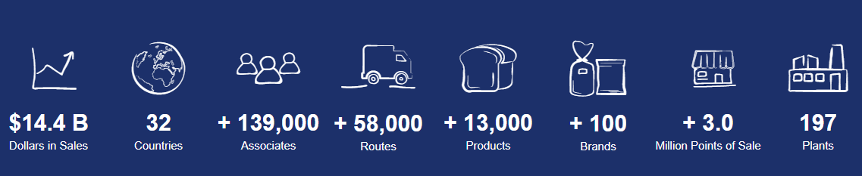
Case: Forecast Inventory Demand
Food Company in Mexico

Slide 27
Goal: Forecast Inventory Demand
Forecast accurate inventory demand
Forecast for each product at each shop (client)
Focusing on 2 town with highest sales (in Pesos)
Business Impact
Avoid empty shelves
Minimize return

Slide 28
Datasets
Table Name | Description
Train | Training set containing historical data
Test | Testing set (without target)
Cliente_tabla | Client names (joining key to Train/Test on Cliente_ID
Producto_tabla | Product names (joining key to Train/Test on Producto_ID
Town_state | Town name (joining key to Train/Test on Agencia_ID)
On Cliente_tabla:
- Duplicated Cliente_ID is NOT acceptable
- Multiuple Cliente_ID can share sama NombreCliente (Nama klien)
On Train: Demanda_uni_equil is always >= 0 (Demand is always 0 or positive)

Slide 29
Field description
Field | Description | Note
Semana | Week number (THU to WED)
Agencia_ID | Sales Depot ID
Canal_ID | Sales Channel ID
Ruta_SAK | Route ID (Several routes = Sales Depot)
Cliente_ID | Client ID
NombreCliente | Client name
Producto_ID | Product ID
NombreProducto | Product Name
Venta_uni_hoy | Sales unit this week | Integer
Venta_hoy | Sales this week | In Peso
Dev_uni_proxima | Returns unit next week | Integer
Dev_proxima | Returns next week | In Peso
Demanda_uni_equil | Adjusted Demand (TARGET) | Integer

Slide 30
Tips: Text processing
Note: This will be useful for cliente_tabla processing.
Pandas lib has built in method for string processing
Series.str.<function>
Series.str.split() → Split strings around given separator/delimiter
Series.str.join(sep) → Join lists contained as elements in the Series

Slide 31
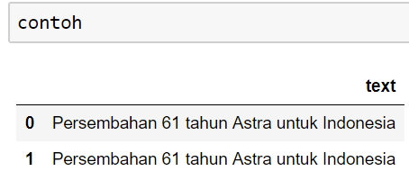
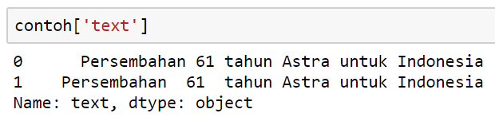
Tips: Text processing
Pandas Data Frame
Pandas Series

Slide 32
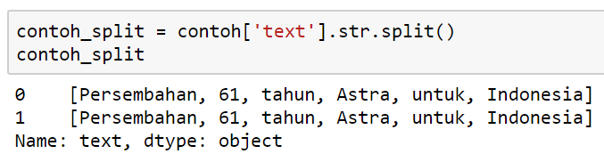
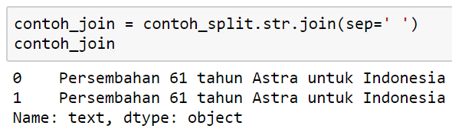
Tips: Text processing
Str.split
Str.join
(Multiple spaces are removed)

Slide 33
Deliverables
Presentation: 15 minutes show time with 10 slides max
Key components for presentation
- Problem statement
- Table pre-processing, joining design
- EDA
- 3 insights at minimum, more will be much appreciated
- Forecasting method, more than 1 is acceptable
- Model evaluation

Slide 34
Team Score
Team member contribution (evaluated by TA)
Deliverable components (evaluated by TA and other Team)
- Table pre-processing & joining design (20)
- EDA (20)
- Insight (20)
- Overall Visualization (20)
- Forecasting method and Performance Measure (20)
Max Score 500 (100x3team + 100x2TA)

Slide 35
10 Jul 2018
Operation Case II
GROUP TASK
Session 2

Slide 36

Learning from OC 1
Go Extra Miles
Genuine Idea
Mastering Topics
Creative Viz
Timing
Dependency
Presentation

Slide 37
Score
 | Pre Process | EDA | Insight | Viz | Forecast
Group 1
Group 2
Group 3
Group 4

Slide 38
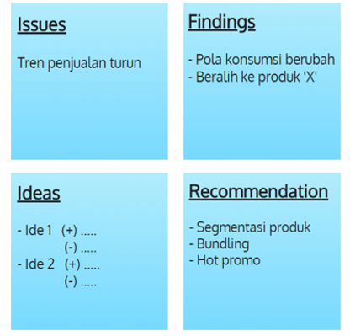
Viz Tips
Sebelum meramu Viz, lakukan Story-Boarding
5 tips visualisasi untuk data Story-Telling
Manfaatkan kekuatan judul
“Penjualan Kuartal 2” VS “Penjualan turun 25%”
Pilih teknik Viz yang efefktif
Arahkan perhatian audience
Jika perlu, tambahkan text
Atur strategi warna
Story-Boarding
Rubrik Business Analytics Majalah Info Komputer, edisi Mei 2018

Slide 39
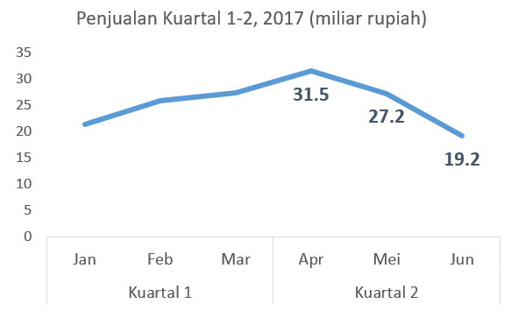
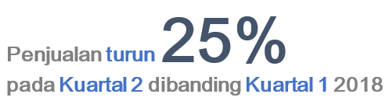
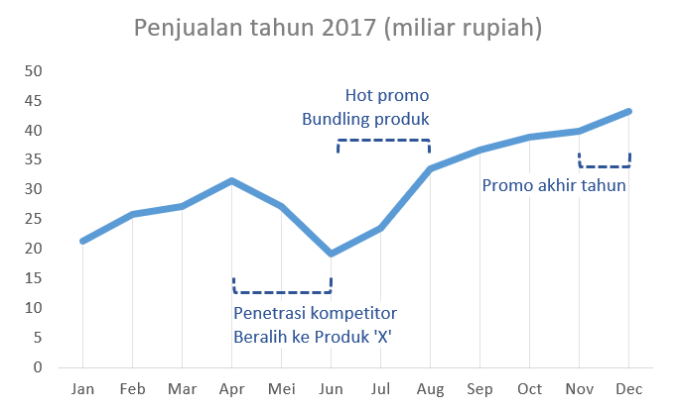
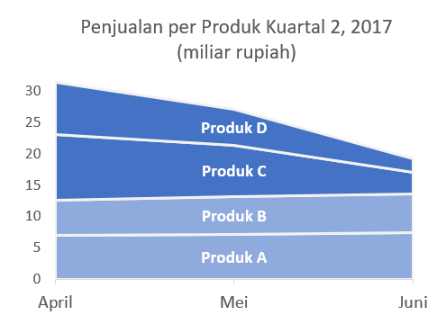
Viz Tips: Example

Slide 40
Check Point
This is an Individual Task
Refreshment of what have been learnt
Opportunity to catch up
Finish STRONG TOGETHER
CP #1
CP #1
CP #1
CP #10

Slide 41
CP #1: Inspect Target
Target exist? (Supv or un-Supv case)
Target data type (Classification or Reg case)
Categorical target: How many classes, how’s the proportion
TASK
Load Dataset-1 (google ‘kyphosis data description’)
Categorical target: Count per class, Class proportion
Visualize target proportion

Slide 42
CP #2: EDA
Get the sense of the data
Get the idea of features predictive-power
TASK
Explore features (eg. distribution, summary statistics, corr)
Explore features r VS target
Identify potential features

Slide 43
CP #3: Feature Engineering
Create features that make ML algorithm works.
Features modification/manipulation to improve model performance.
TASK
Convert feature ‘Age’ to year-unit (replacing original one)
Create Age-group in year-unit (‘yr <=1’, ‘1 < yr < 5’, ‘yr >= 5’)
Create Number-group (find the best split)

Slide 44
CP #4: Prepare data for modeling
ML algorithm accept numerical value.
Encode categorical features / create dummy variable.
Split data to train-test set
TASK
Encode categorical features
Prepare data-frame for modeling (all features including dummy variable and target)
Split data to train-test set (train/test = 70/30)

Slide 45
CP #5: Prepare data for modeling
ML algorithm accept numerical value.
Encode categorical features / create dummy variable.
Split data to train-test set
TASK
Encode categorical features
Prepare data-frame for modeling (all features including dummy variable and target)
Split data to train-test set (train/test = 70/30)

Slide 46
CP #5: Modeling
Predict target of test-data
Use either Logistic Regression or Decision Tree
TASK
Modeling
Predict target of test-data

Slide 47
CP #7: Model Evaluation
Use different types of model performance metrics.
Accuracy, Sensitivity, Specificity, ROC, etc
TASK
Modeling
Create Confusion Matrix
Create User Defined Function to automatically calculate confusion-matrix based performance metrics
Plot ROC

Slide 48


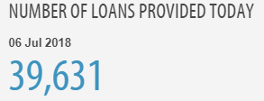



Case: Home Credit Default Risk
International Consumer Finance Provider

Slide 49
Goal: Predict Repayment Abilities
Predict those with payment difficulties
Business Impact
Broaden financial inclusion to unbanked population
Minimize case of repayment failure

Slide 50
Datasets
Table Name | Description
Application_train | Main table, static data for all applicants, with TARGET
Application_test | Main table, static data for all applicants, without TARGET
Bureau | Client’s previous credit by other financial institution
Bureau_balance | Monthly balances of previous credit in Credit Bureau
Credit_card_balance | Monthly balance snapshot of previous credit cards with Home Credit
POS_CASH_balance | Monthly balance snapshots of previous POS (point of sales) and cash loans that the applicant had with Home Credit
Previous_application | Previous applications for Home Credit loans of clients who have loans in our sample
Installment_payments | Repayment history for the previously disbursed credits in Home Credit related to the loans in our sample.

Slide 51
Field Description
Field description is provided in csv file
HomeCredit_columns_description.csv

Slide 52
Deliverables
Presentation: 15 minutes show time with 10 slides max
Key components for presentation
- EDA (show only important viz)
- 3 insights at minimum
- Model/algorithm selection, more than 1 is accepted
- Model evaluation (ROC, Confusion Matrix)
- Variable Importance
- Recommendation
Extra point:
Feature Engineering, HyperParameter Tuning, Resampling

Slide 53
IYKRA
Ariobimo Sentral Kuningan, Block 71 Lantai 8.
Jl. HR Rasuna Said Blok X-2, Kav. 6, Kuningan
Jakarta 12950
Thank you

